Slide 1
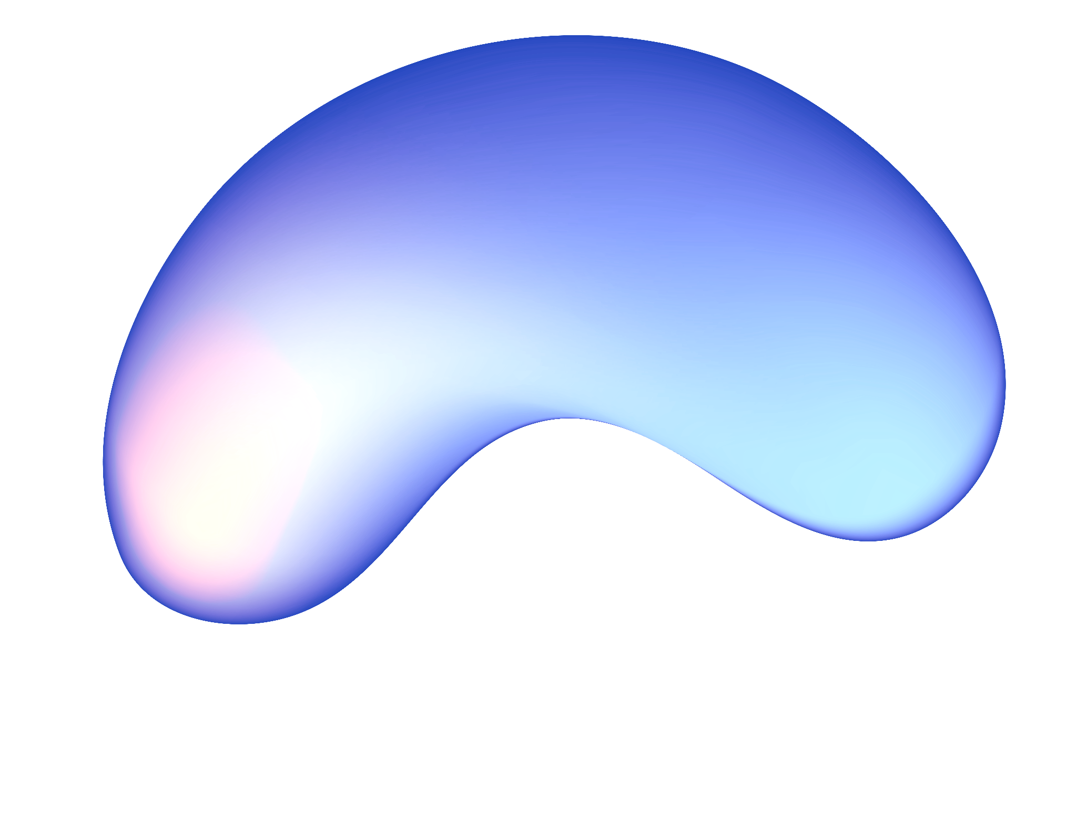

SENTIMENT ANALYSIS FOR CLIMATE CHANGE
SENTIMENT
ANALYSIS FOR
CLIMATE CHANGE
Alberto Formaggio 21145148 – Data Mining NDBI023

Slide 2

WHAT IS SENTIMENT ANALYSIS?
WHAT IS SENTIMENT ANALYSIS?
Sentiment analysis is the process of analyzing online pieces of writing to determine the emotional tone they carry, whether they’re positive, negative, or neutral.
In simple words, sentiment analysis helps to find the author’s attitude towards a topic.
In our case, we are going to create a model to study the attitude of people towards Climate Change by scraping tweets from Twitter.
We must combat climate change. Indigenous ppl are protesting for our earth, our water. Yet this happens: https://t.co/EUDmjbgbkx
@crabtrem Yes! Imagine all the money wasted. Trump's plan to ditch payments for climate change will save us billions!!

Slide 3


PRE-PROCESSING
O1

Slide 4
THE CLEANING PROCESS
Words can have spelling errors that add noise to the data
Sentences are split into lists of tokens
Spell-checking
Tokenization
4
Text Cleaning
Lemmatization
Words get substituted by their lemma
Lowercasing.
Punctuation, Mentions, Hashtags removal. Removal of stopwords

Slide 5

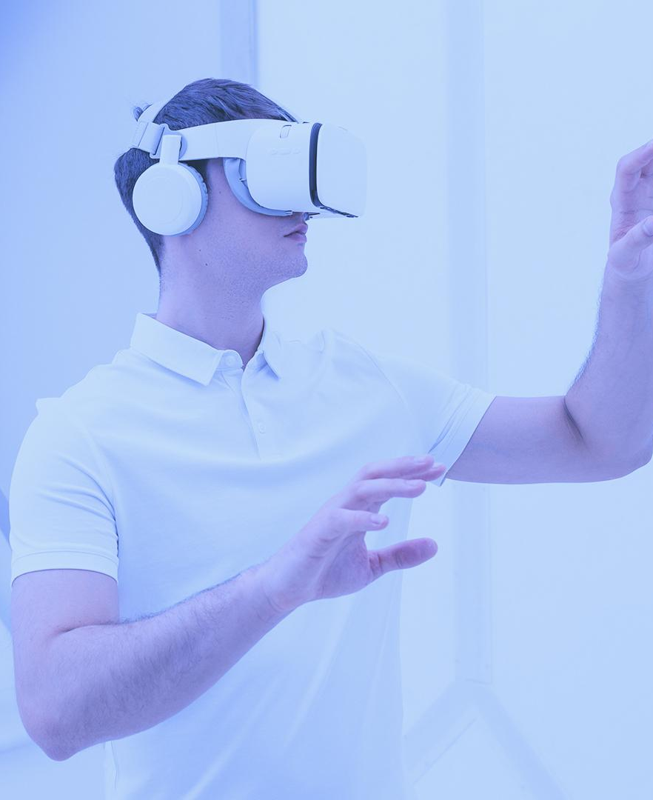
DATA ANALYTICS
O2

Slide 6
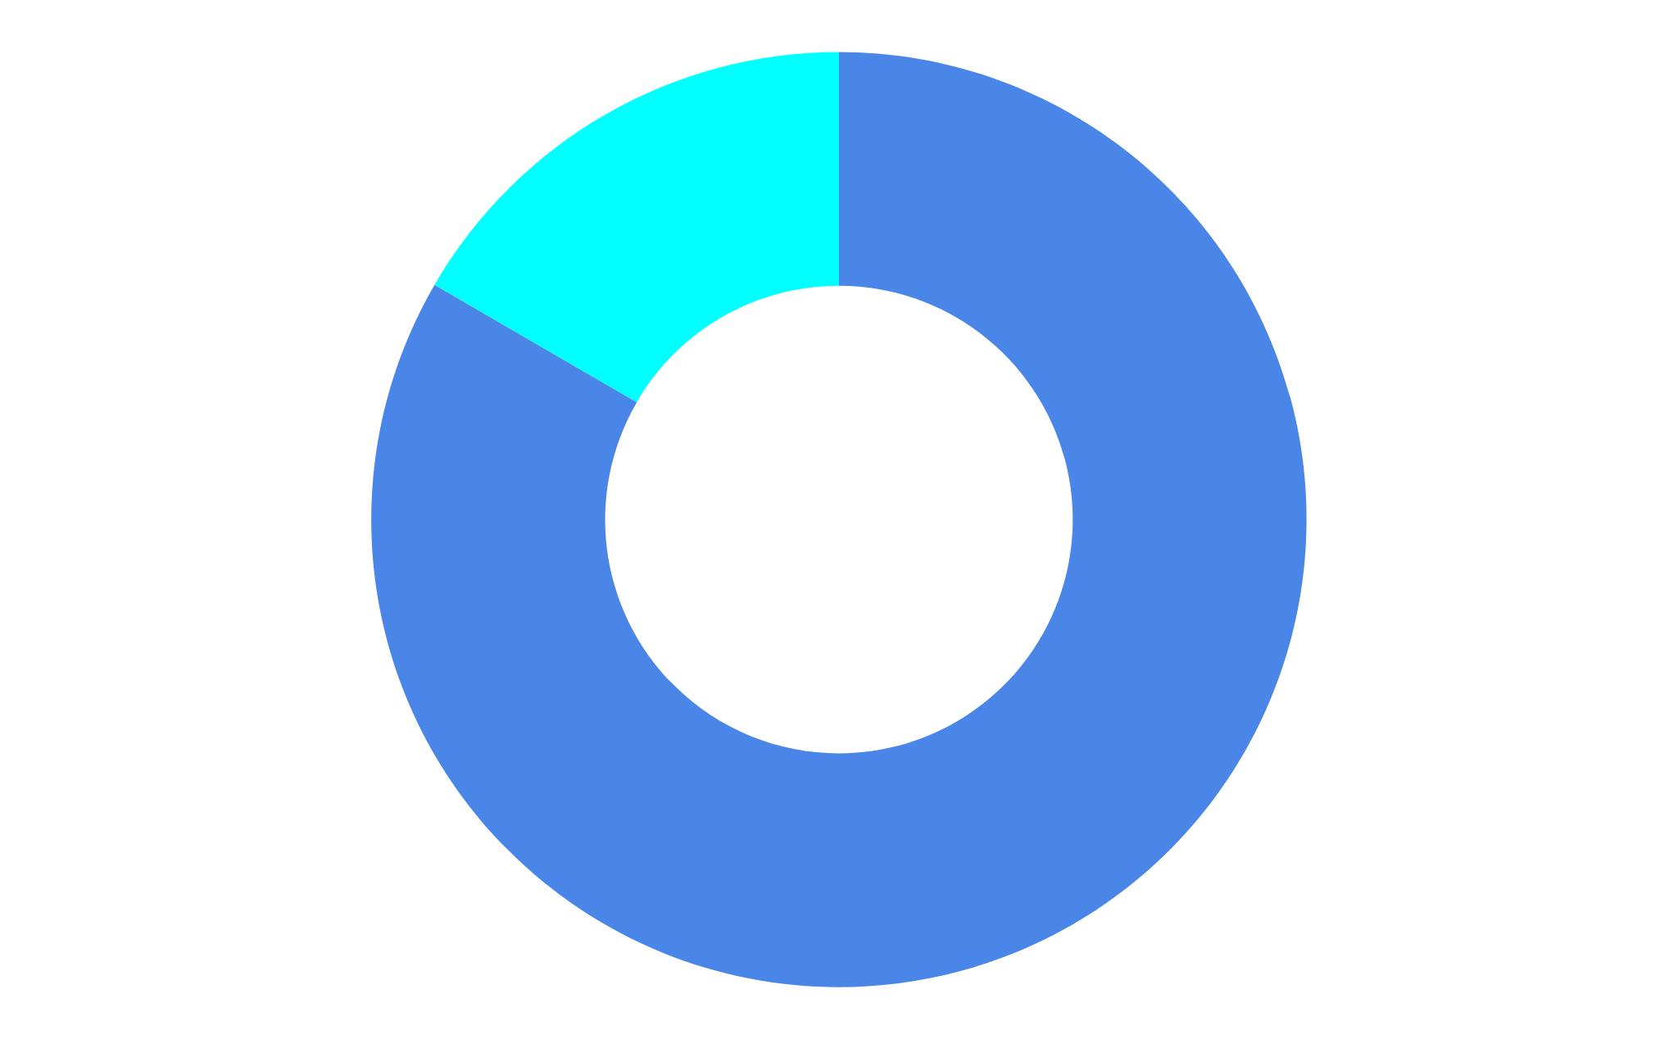
CLASS DISTRIBUTION
84.2%
POSITIVE
Tweets that express support to Climate Change
4
15.8%
NEGATIVE
Tweets of people that don’t think Climate Change is an issue
We can see that we have class unbalance in our training data, we must take this into account when training the classifiers.

Slide 7

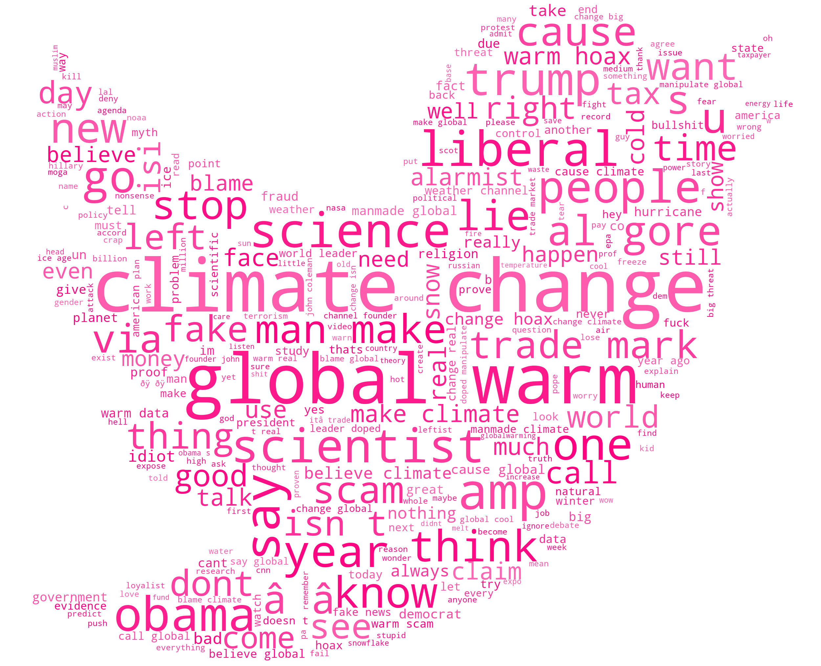
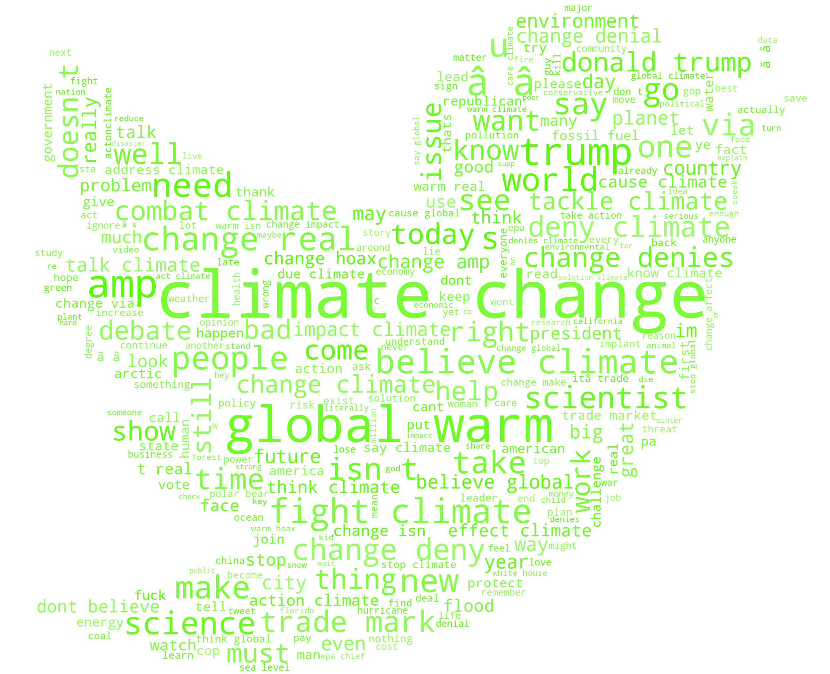
WORD DISTRIBUTION
WordCloud was used to get useful insight into the word distribution. We can see here the distributions of the words separated by class.
Negative
1
Positive

Slide 8
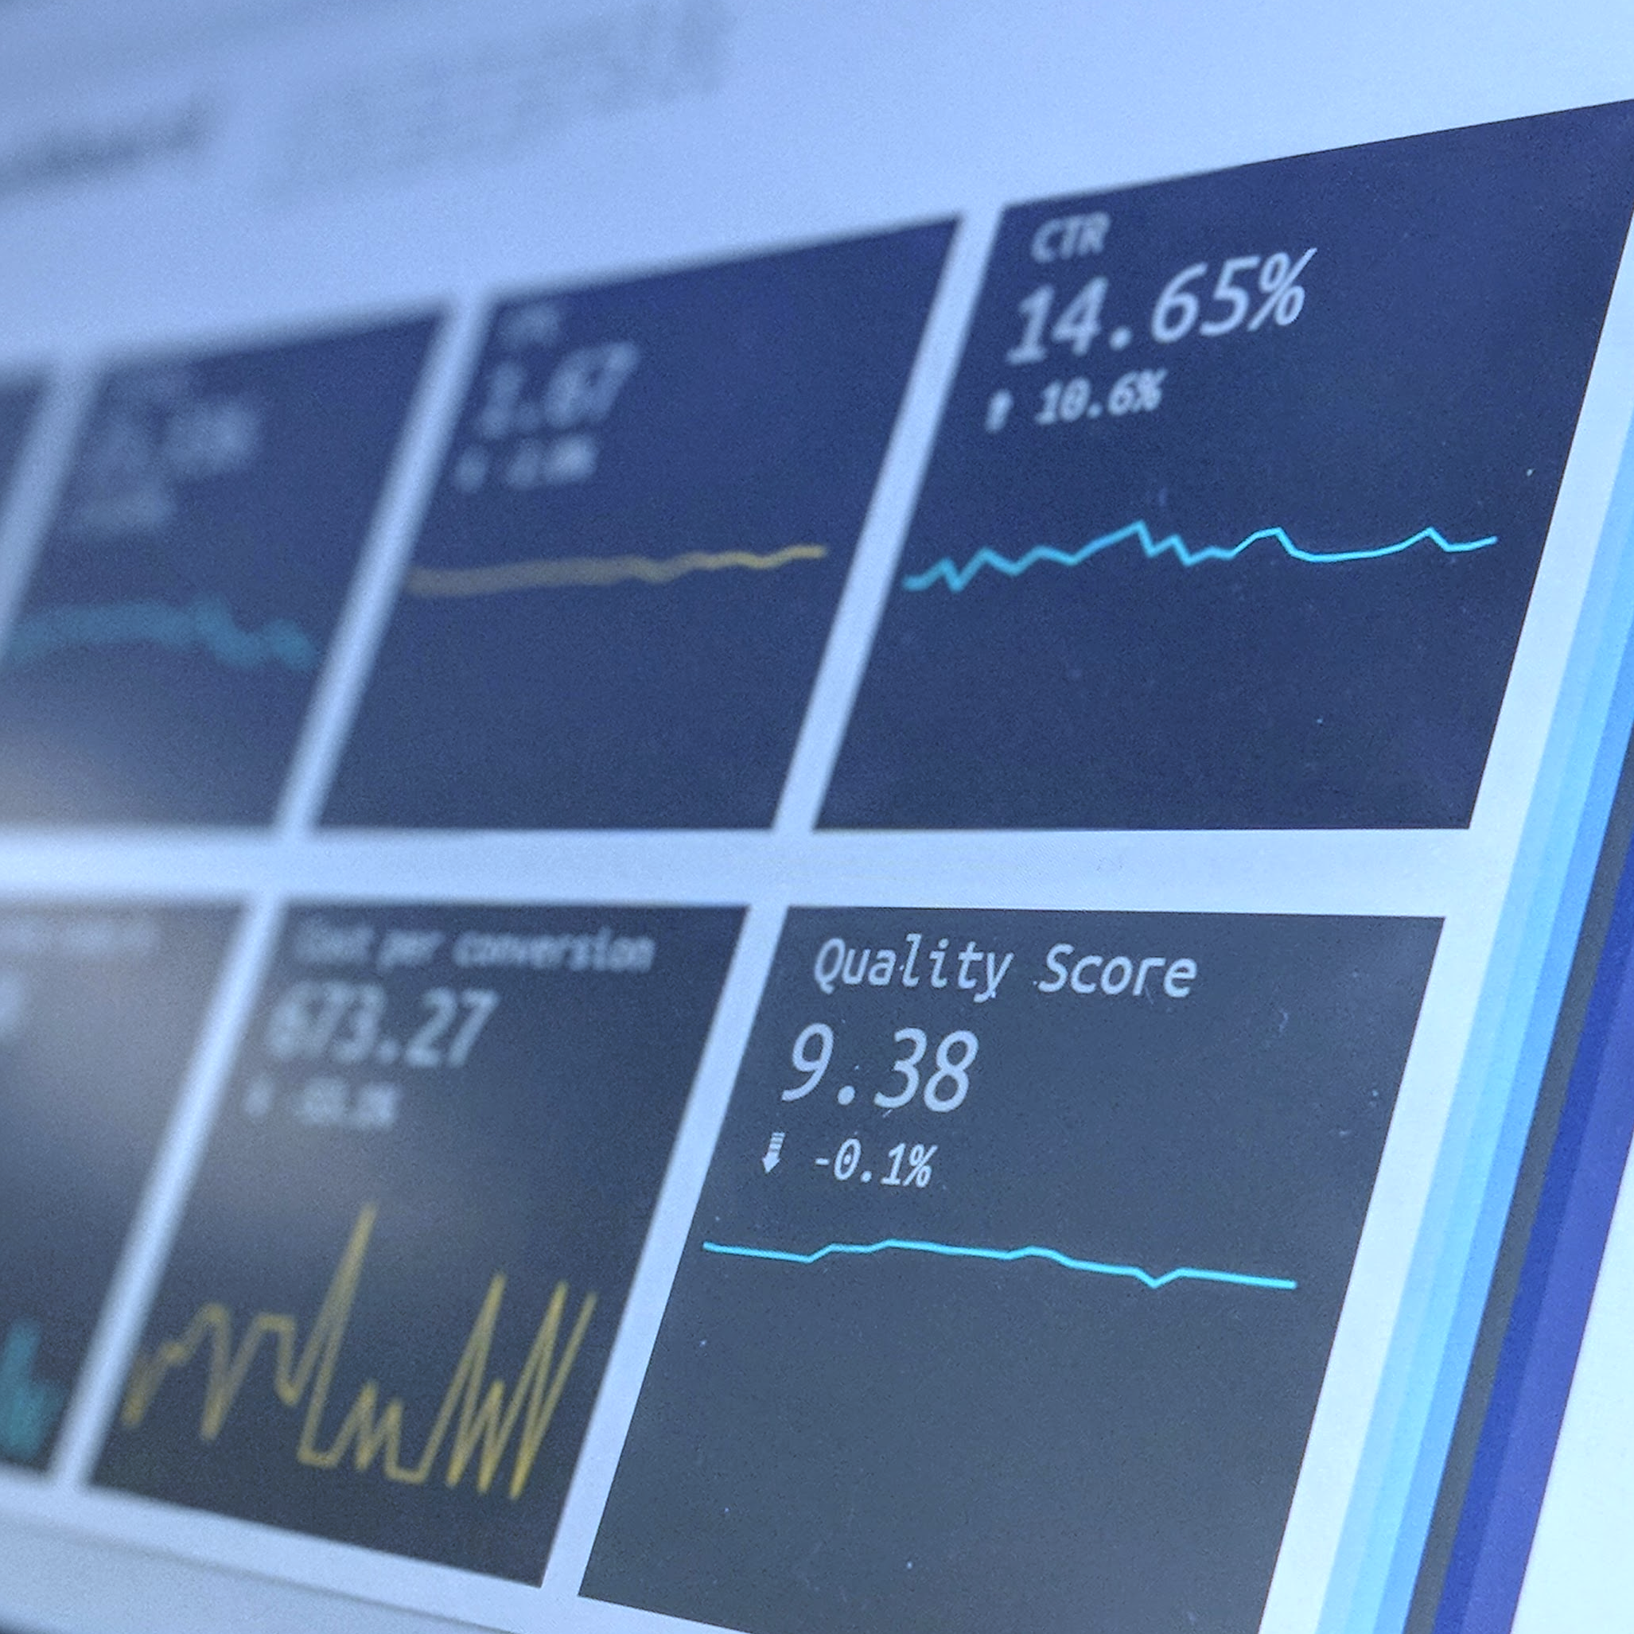
MINING PROCESS
03

Slide 9

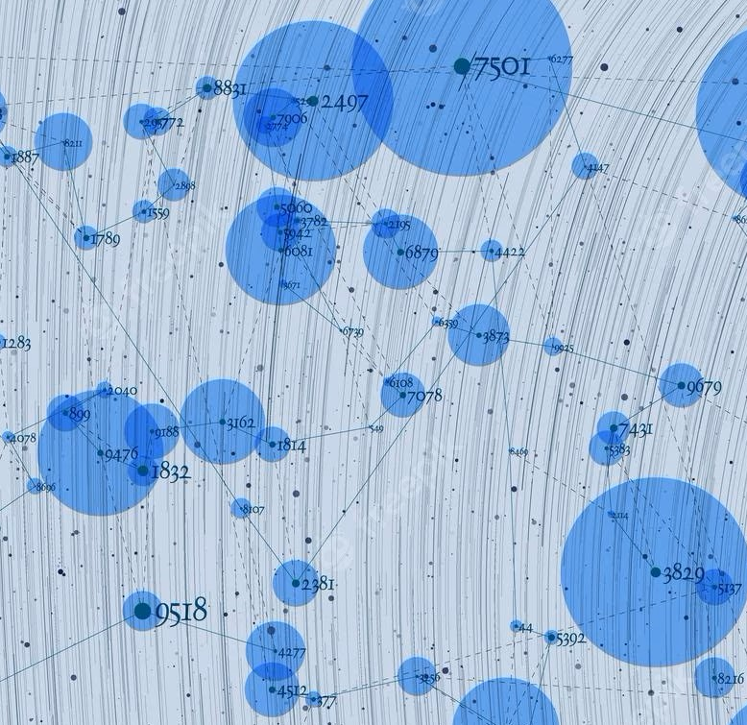
TEXT PROCESSING APPROACHES
BAG OF WORDS
TF - IDF
WORD EMBEDDING
TF-
IDF
1
Bag of words is a measure that considers the number of times that a word (or bigram, trigram, etc.) appears in a sentence.
TF-IDF is a statistical measure that evaluates how relevant a word is to a document in a collection of documents.
Word embeddings are used to display words in the feature space in such a way that similar words are close to each other.

Slide 10
RESULTS WITH BAG OF WORDS
 | ACCURACY | PRECISION | RECALL | F1-SCORE
MULTINOMIAL BAYES CLASSIFIER | 87.6% | 77% | 79% | 78%
LOGITSTIC REGRESSION | 86.7% | 75% | 78% | 77%
LINEAR SVM | 87.2% | 76% | 78% | 77%
NEURAL NETWORK | 89.3% | 78% | 78% | 78%
2
Bigrams and unigrams with a maximum of 15000 features were used. This number was chosen according to the computational power available.
Probably the results can be improved with more powerful hardware.

Slide 11
RESULTS WITH TF-IDF
 | ACCURACY | PRECISION | RECALL | F1-SCORE
MULTINOMIAL BAYES CLASSIFIER | 89.7% | 86% | 76% | 76%
LOGITSTIC REGRESSION | 90.8% | 85% | 78% | 81%
LINEAR SVM | 91.2% | 87% | 78% | 81%
NEURAL NETWORK | 87.8% | 77% | 79% | 78%
2
Bigrams and unigrams with a maximum of 15000 features were used. This number was chosen according to the computational power available.
Probably the results can be improved with more powerful hardware.

Slide 12
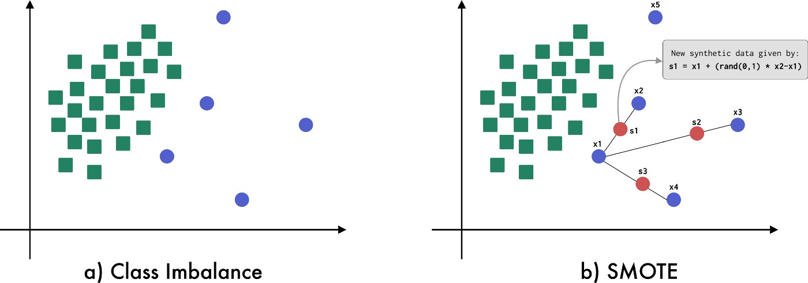
HOW WAS CLASS IMBALANCE TACKLED IN THESE 2 MODELS?
When we have class imbalance, training the model without any change would lead to a model biased towards the majority class.
This problem can be overcomed as follows:
Downsampling
Oversampling
Oversampling with SMOTE led to the best performance.
Furthermore, the macro average of the F1-score metric was used to assess the goodness of the model rather than the accuracy
1

Slide 13
CHOICE OF THE BEST WORD EMBEDDING
We tested 2 different Word Embeddings in order to find the most suitable one for our task:
Google News Word2Vec: It contains vectors trained on 100 billion words from the Google News dataset. The resulting vectors have 300 features.
Global-Vector Twitter: It contains pre-trained vectors trained over tweets. The resulting vectors have 200 features.
The results were obtained by applying a Logistic Regression classifier.
 | ACCURACY | PRECISION | RECALL | F1-SCORE
WORD2VEC | 84.0% | 71% | 75% | 73%
GLOVE | 81.3% | 67% | 70% | 68%
2

Slide 14
RESULTS WITH WORD EMBEDDINGS
 | ACCURACY | PRECISION | RECALL | F1-SCORE
LINEAR SVM | 84.4% | 72% | 76% | 73%
POLY-KERNEL SVM | 86% | 74% | 79% | 76%
NEURAL NETWORK | 86.7% | 75% | 80% | 77%
RNN | 88.1% | 78% | 75% | 76%
2
The parameters for non-neural network approaches were computed optimally by using Cross Validation (GridSearchCV).

Slide 15
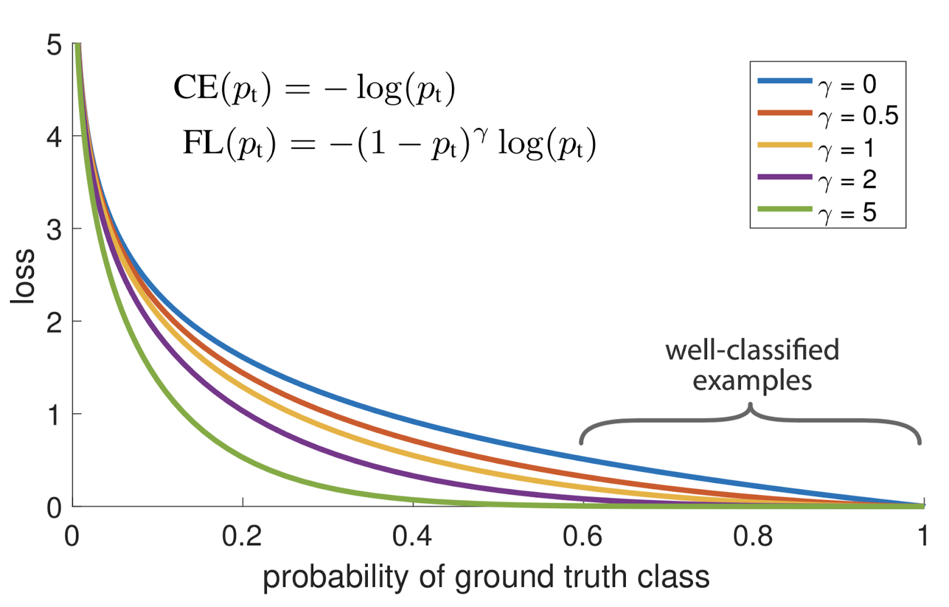

HOW WAS CLASS INBALANCE HANDLED WITH WORD EMBEDDINGS?
Unfortunately SMOTE is not working well with Word Embeddings, so a new approach was needed.
I tried:
Downsampling
Change class weights
Focal Loss
Out of these approaches we used:
Focal Loss for NNs and RNNs
No modification of data for the other models
1

Slide 16
COMPARISON WITH STATE-OF-THE-ART MODELS
 | ACCURACY | PRECISION | RECALL | F1-SCORE
VADER (NO FINE TUNING) | 57.8% | 52% | 53% | 48%
DISTILBERT (BS=32, WITH PREPROCESSING) | 87.9% | 77% | 84% | 80%
DISTILBERT (BS=64, W/O PREPROCESSING) | 92.8% | 88% | 84% | 86%
DISTILBERT (BS=64, WD=0.01, W/O PREPROCESSING) | 92.4% | 86% | 86% | 86%
2
BS = Batch Size, WD = Weight decay.
DistilBERT = lighter and faster BERT implementation, appropriate when the hardware is limited

Slide 17

CONCLUSIONS
CONCLUSIONS
BEST PERFORMING MODEL: BERT
PROS:
Good performance (86% F1-score)
CONS:
High training time required
Many resources needed
Hard to implement
2° BEST MODEL: LINEAR SVM WITH TF-IDF
PROS:
Fast training Time
Easy to understand
CONS:
Slightly less precise than BERT
1

Slide 18

THANKS
THANKS
Do you have any questions?

